Slide 1
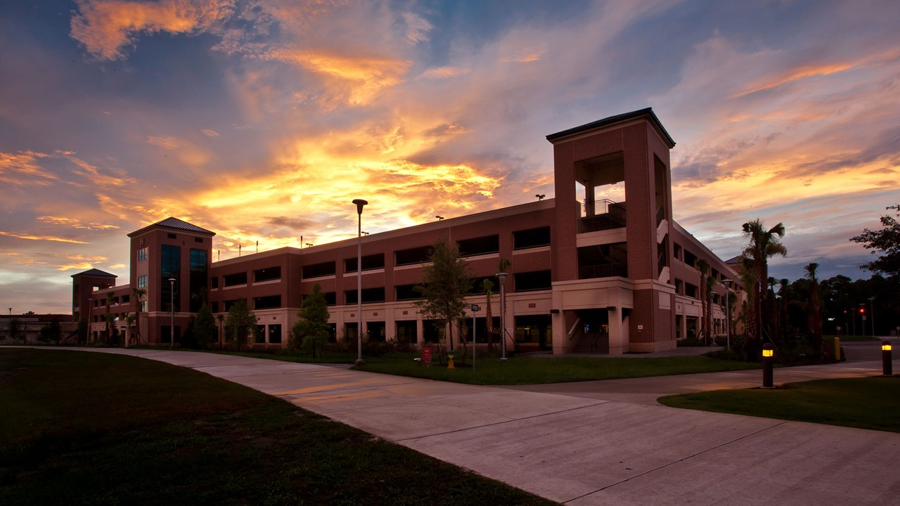
Smart Parking System
Oscar Acuna | Jordan Johnson
M. Ridwan | Kyle Carpenter
Group B

Slide 2



Oscar Acuna
Computer Engineering
oacuna@knights.ucf.edu
Jordan Johnson
Electrical Engineering
jordan614407@knights.ucf.edu
M. Ridwan
Computer Engineering
mridwan@knights.ucf.edu
Kyle Carpenter
Computer Engineering
kylecarpenter@knights.ucf.edu

Slide 3
Project Description
Jordan Johnson
A parking garage guidance system that computes what rows have open spots and what rows are fully occupied and directs drivers accordingly
Takes an unconventional approach by using cameras and image processing techniques rather than sensors
Includes a website and control unit that will collect information from the camera in real time.
A proof of concept that could be scalable with more resources

Slide 4
Motivation
Jordan Johnson
UCF’s growing population has lead to more cars being on the campus
During times of heavy traffic flow, UCF’s parking garages become congested and create a variety of problems
Signs outside of each garage indicating “open” or “full” do not give enough information about the parking situation inside of the garage
Designing a modern parking system will help students and faculty be on time to classes

Slide 5
Goals and Objectives
Kyle Carpenter
Use Computer Vision to detect cars passing through region
Use LED displays to communicate total open parking spaces in region of garage
Develop the system for low power consumption (Not high priority since not battery driven)
Utilize ethernet for communication between camera, backend server, and sign display

Slide 6
Specifications and Requirements
Kyle Carpenter
Component | Parameter | Specification
System | Accuracy/Time | 100% accurate after 60 sec
↑↑↑ | ↑↑↑ | 90% accurate after 30 sec
LED Display | Min Brightness | 1,000 nits
User site | Interface | User friendly interface
Computer Vision | Detection | Consistent vehicle detection in parking spot region
Camera | Power | Power over Ethernet

Slide 7
Division of Labor
Kyle Carpenter
 | Oscar | Ridwan | Jordan | Kyle
PCB Design |  |  | ✔
Camera Programming |  | ✔
MCU/LED Programming |  |  |  | ✔
Server Programming | ✔

Slide 8
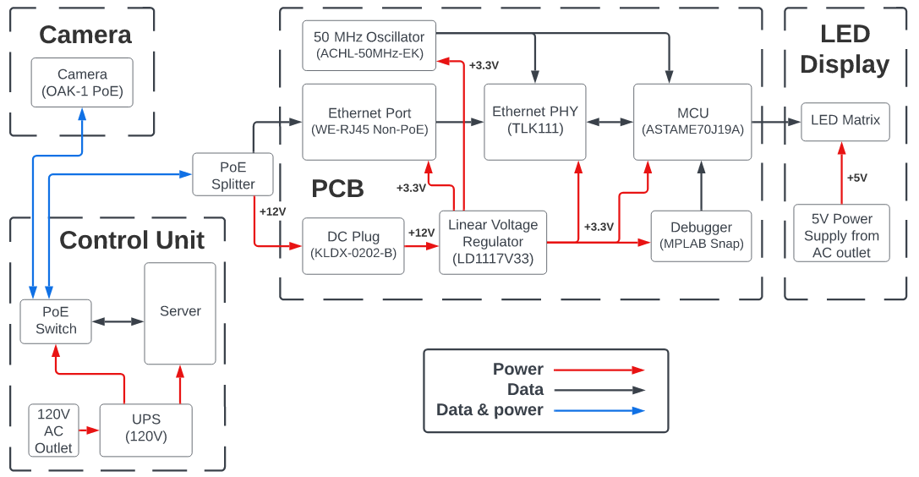
Overall System - Hardware Block Diagram
M Ridwan

Slide 9
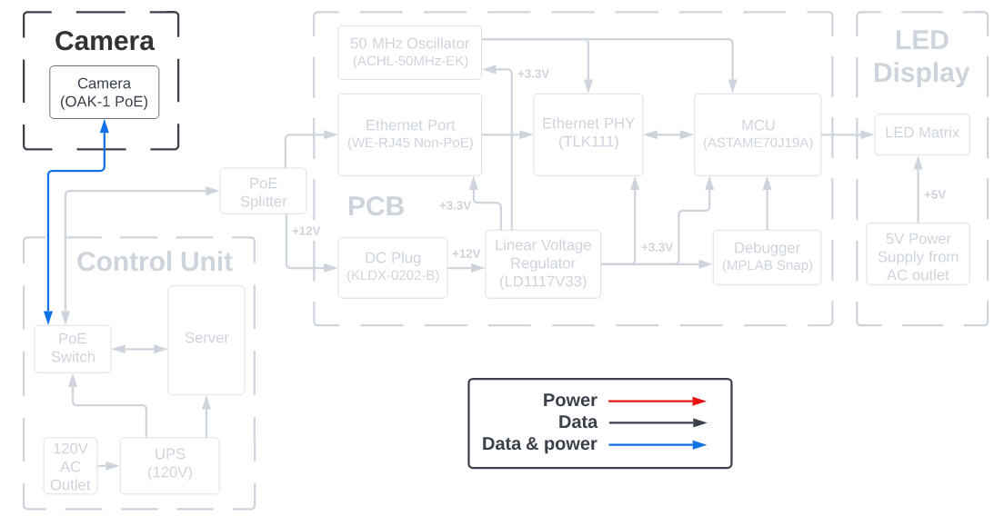
Camera - Hardware Block Diagram
Kyle Carpenter

Slide 10
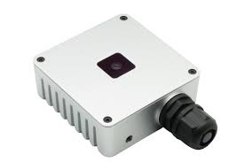
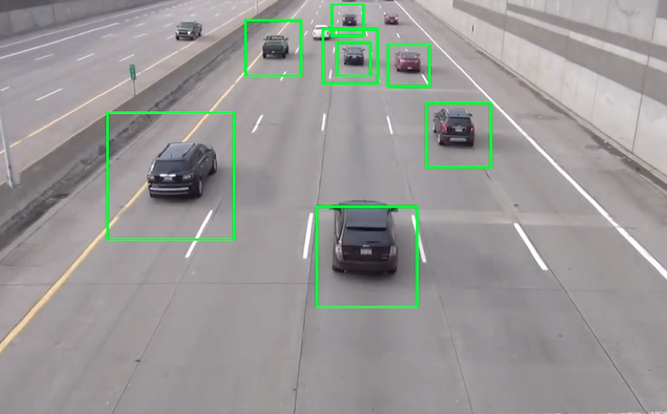
Camera
OAK-1 PoE
Integrated video processing unit allows computer vision to be done on the camera
Utilizes Power over Ethernet connection
Easy computer vision setup using DepthAI library
Large amounts of open source examples available (e.g. vehicle detection CV)
Allows for high level scripting
Kyle Carpenter
Notes:
Something to note: alleviates processing needed from server since it only is receiving data on car count, no image processing

Slide 11
Camera (continued)
OAK-1 PoE
Downsides
Expensive camera module relative to other IP cams
Advantages
Offloads work from the backend
Allows large distance between cam and server
Kyle Carpenter
Notes:
Something to note: alleviates processing needed from server since it only is receiving data on car count, no image processing

Slide 12
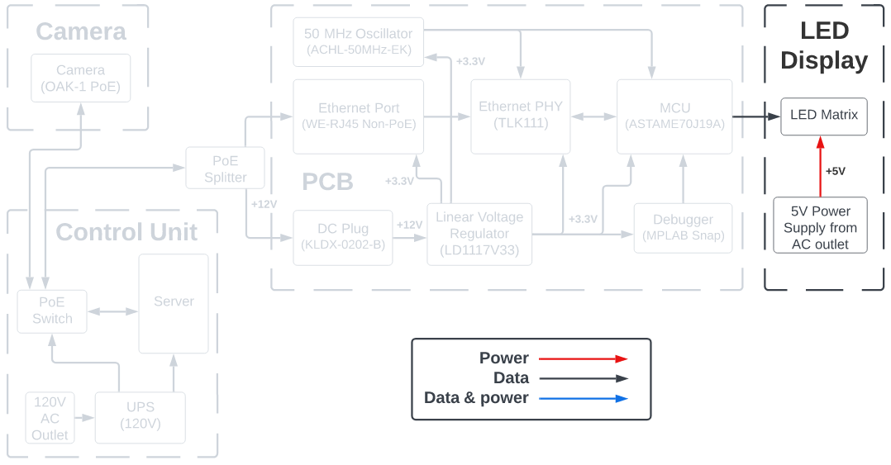
LED Display - Hardware Block Diagram
Kyle Carpenter

Slide 13
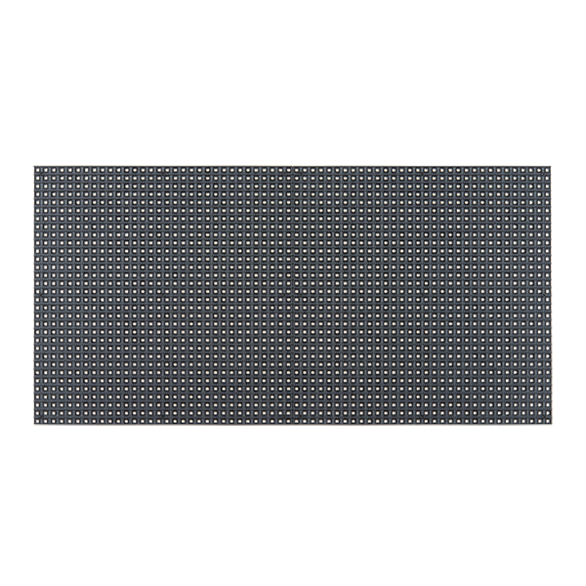
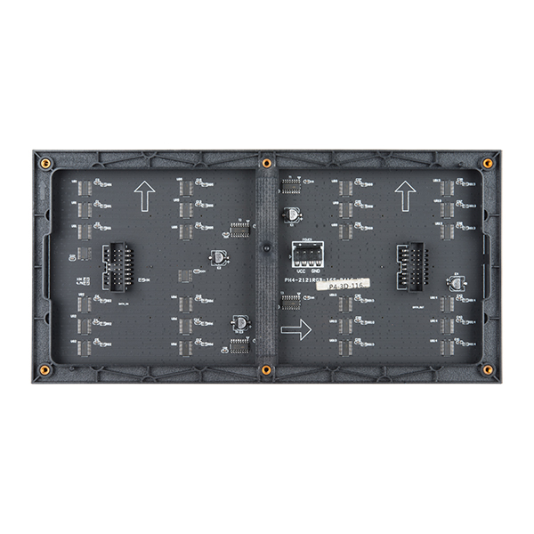
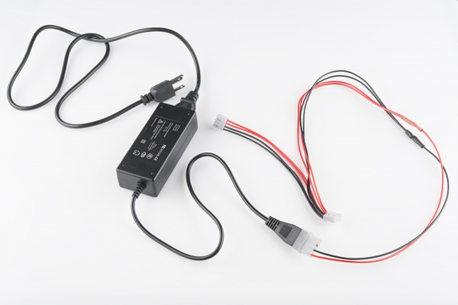
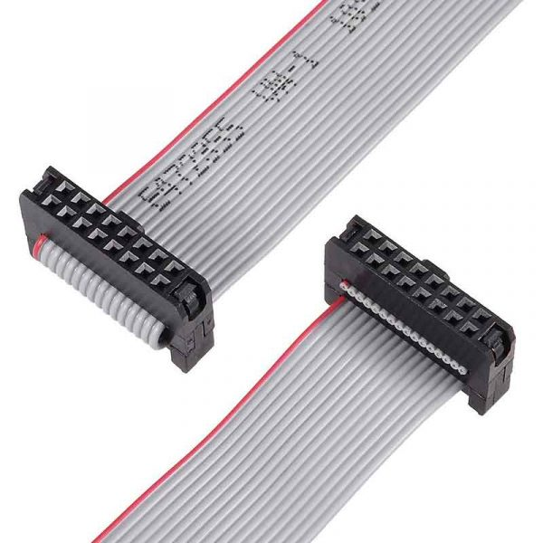
Display
Kyle Carpenter
LED Matrix
32 x 64 (2048 LEDs)
Uses 16-pin ribbon cable for data communication
Uses 4-pin molex connector for interface with 5V power supply

Slide 14
Display (continued)
Kyle Carpenter
LED Matrix
1/16 scan rate
LEDs driven via few pins from shift registers and multiplexed pins
Daisy-chainable

Slide 15
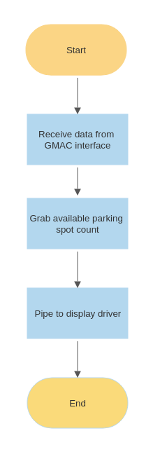
MCU Display Software
Kyle Carpenter
Overall design is simple
Complexity is in the drivers
Custom driver needed for LED display
Match pixels to chars
Match pixels to pins

Slide 16
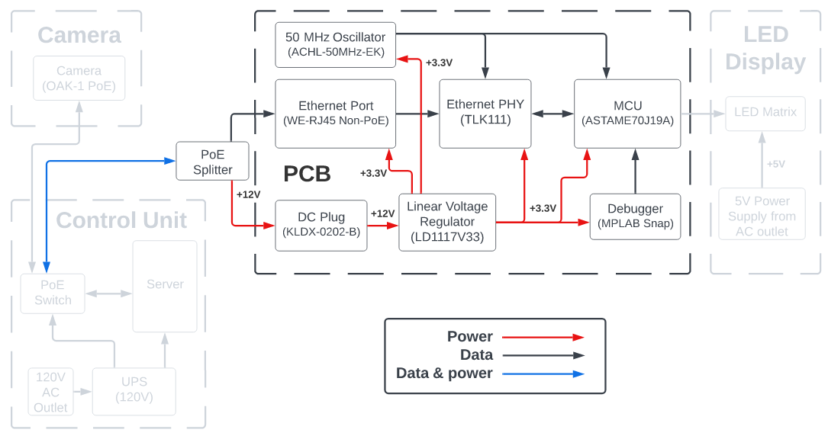
PCB - Hardware Block Diagram
Jordan Johnson

Slide 17
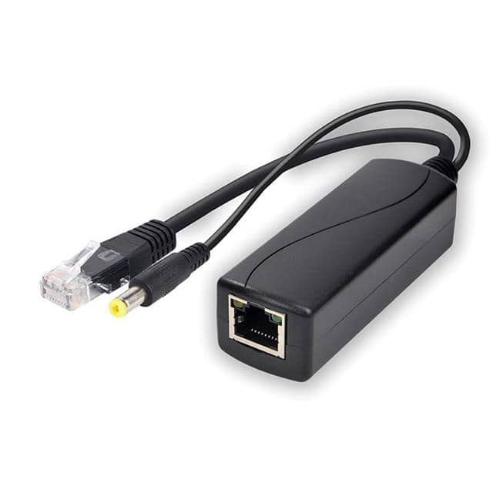
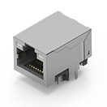
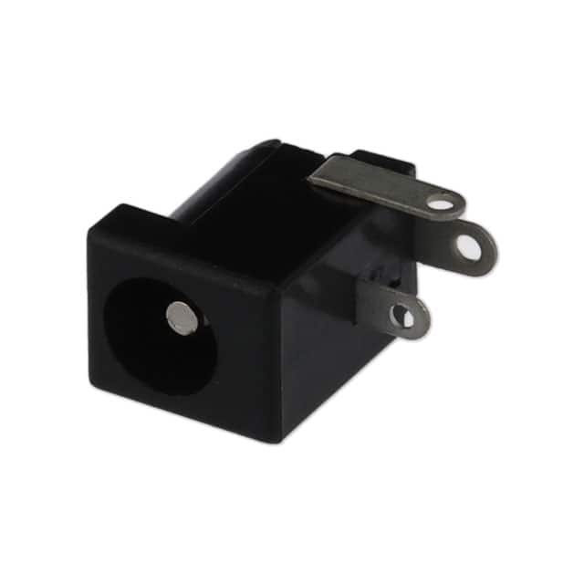
PCB Components
Power over Ethernet (PoE) Splitter
Allows power and data to be on two separate connections
$14.54
Ethernet Port
Receives ethernet connection from PoE splitter
Interfaced with Ethernet PHY
$6.20
DC Plug
Receives 12V power connection from PoE splitter
$0.74
Jordan Johnson

Slide 18
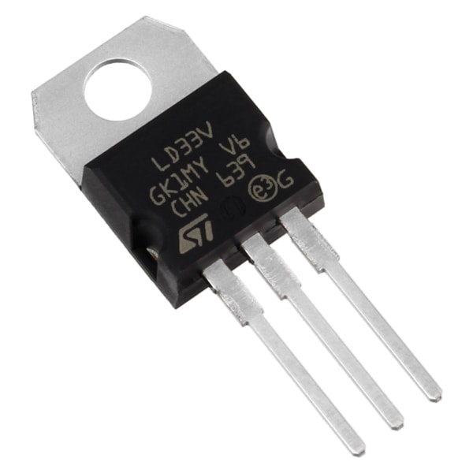
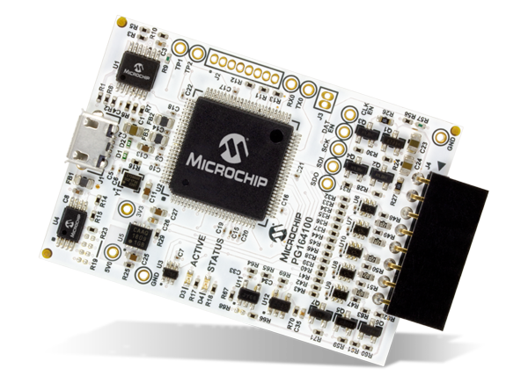
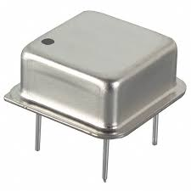
PCB Components
Voltage Regulator
Regulates +12V input to +3.3V
$6.99 (Pack of 6)
MPLAB Snap
Includes SWD debug interface for communication with ATSAME70J19A, TLK111, and LED Matrix
$34.09
50 MHz Oscillator
Clock signal for TLK111 and ATSAME70J19A
Signal is fed into TLK111 which generates a reference clock signal for the the ATSAME70J19A
$2.61
Jordan Johnson

Slide 19
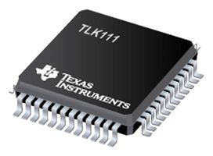
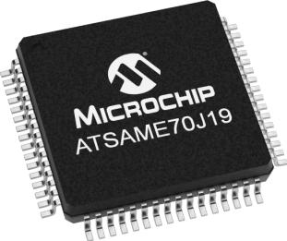
PCB Components
TLK111
48-LQFP
Controls status LEDs on ethernet port
Communicates with Media Access Control (MAC) block on MCU
Allows for interface between ethernet port and MCU
$11.34
ATSAME70J19A
64-LQFP
Includes MAC block for ethernet communication
Includes 44 GPIO pins for communication with LED Matrix
Serial Wire Debugging
$12.63
Jordan Johnson

Slide 20
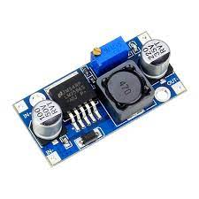
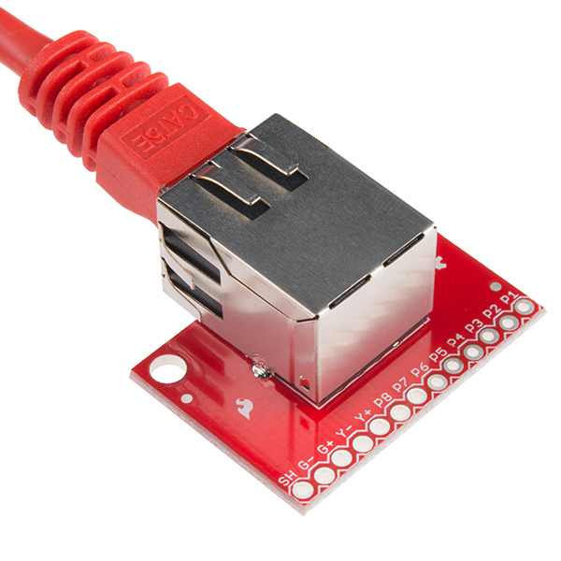
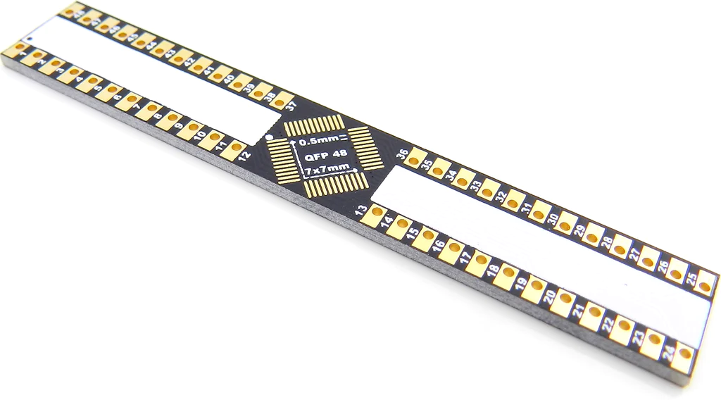
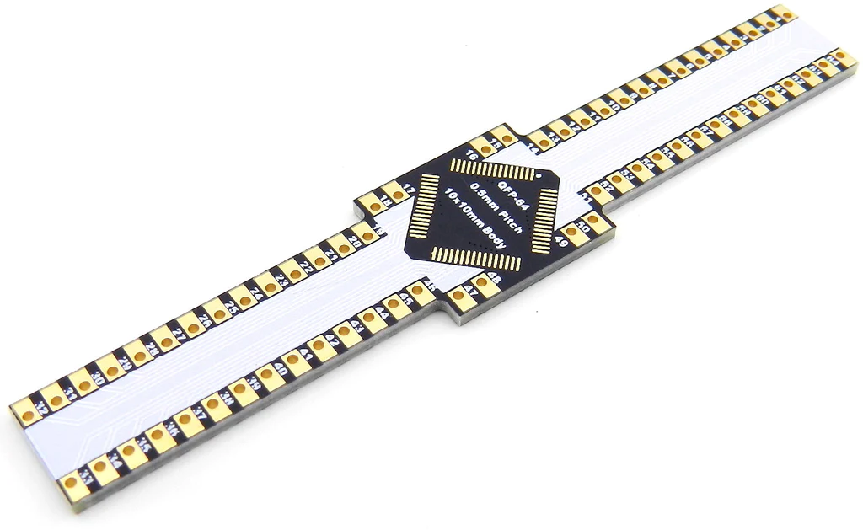
Breadboard Components
Adjustable Buck Converter
DC to DC Buck Converter used for prototyping purposes
$10.69 (Pack of 6)
RJ45 MagJack Breakout
RJ45 Breakout Board with integrated magnetics for easy prototyping with Ethernet PHY
$6.95
LQFP-64 & LQFP-48 Breakout Boards
Adapter for microchip pins to breadboard
$9.95
$6.95
Jordan Johnson

Slide 21
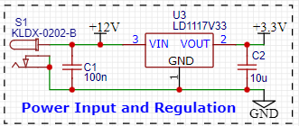
PCB Schematic (Power Input & Regulation)
+12V input from Power over Ethernet Splitter into DC Barrel Jack
LD1117V33 regulates this +12V input to +3.3V
Jordan Johnson

Slide 22
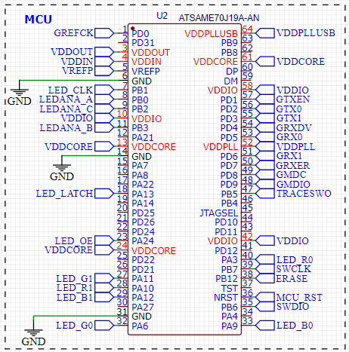
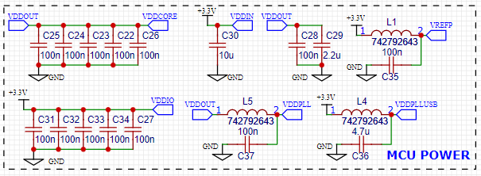
PCB Schematic (MCU)
Includes connections for:
Serial Wire Debugging (SWD)
LED Sign
Reduced Media Independent Interface (RMII) for communication with Ethernet PHY
Single power supply input
Makes use of internal voltage regulator (VDDIN & VDDOUT) for pins that don’t receive +3.3V (VDDPLL & VDDCORE)
Jordan Johnson

Slide 23
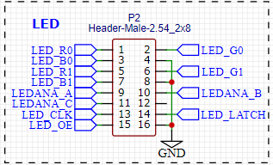
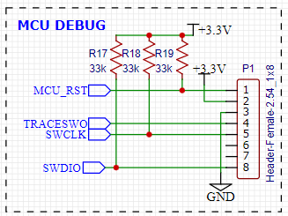
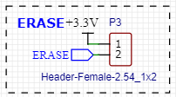
PCB Schematic (MCU Continued)
PCB includes one male and two female pin headers
LED Header (2x8 Male)
Uses 12 GPIO pins on the MCU to communicate with the LED Matrix
MCU Debug Header (1x8 Female)
Uses SWD pins on the MCU to connect with the MPLAB Snap Debugger
Erase Header (1x2 Female)
Needed for any situation where we need to erase the firmware on our device
Jordan Johnson

Slide 24
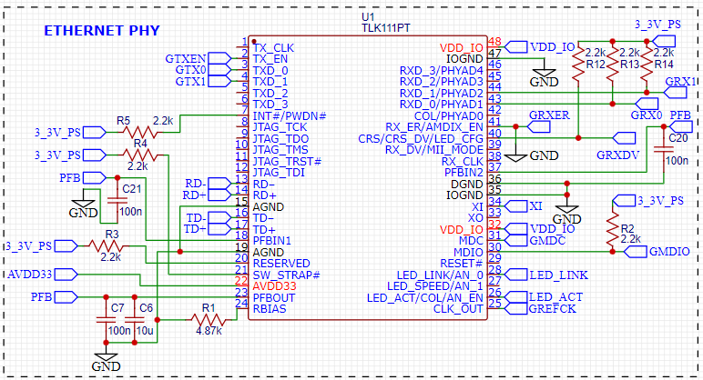
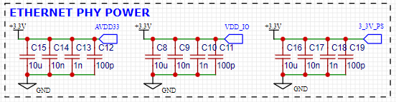
PCB Schematic (PHY)
Includes connections for:
Ethernet Port
LEDs
Physical Medium Dependent (PMD) Interface
Reduced Media Independent Interface (RMII) for communication with MCU Media Access Control (MAC) block
Single power supply input
Makes use of internal voltage regulator (PFBOUT) for pins that don’t receive +3.3V (PFBIN1 & PFBIN2)
External 50 MHz Oscillator
Jordan Johnson

Slide 25
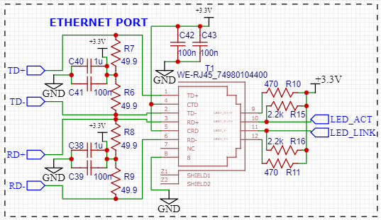
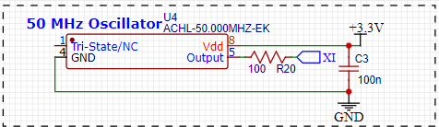
PCB Schematic (PHY Continued)
Ethernet Port
Connected to PHY through PMD interface and status LEDs
50 MHz Oscillator
Receives +3.3V and generates a 50 MHz signal which is fed into the Ethernet PHY
Jordan Johnson

Slide 26
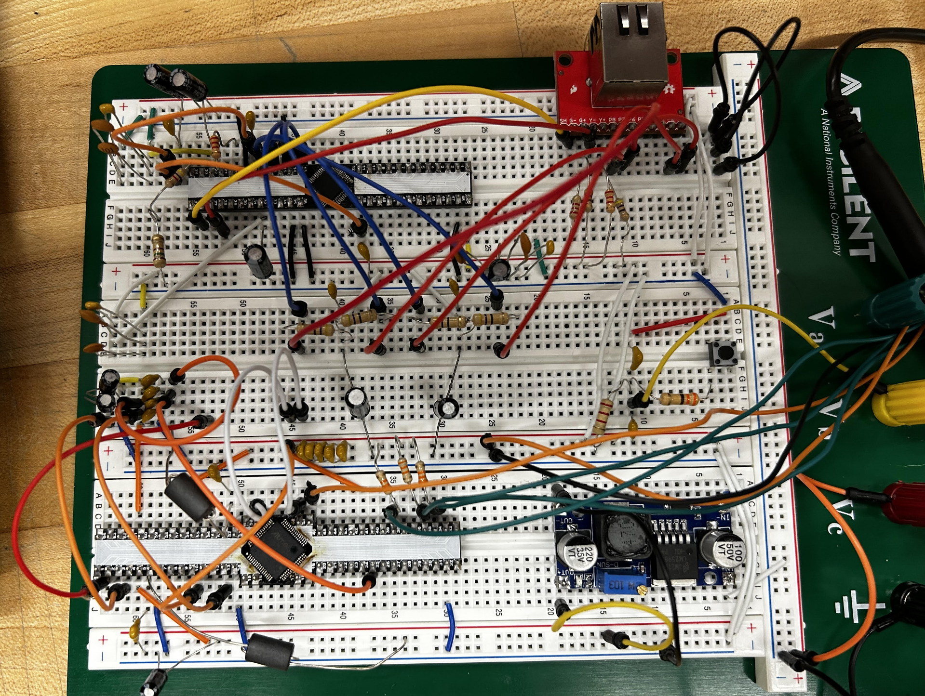
Breadboard
Jordan Johnson

Slide 27
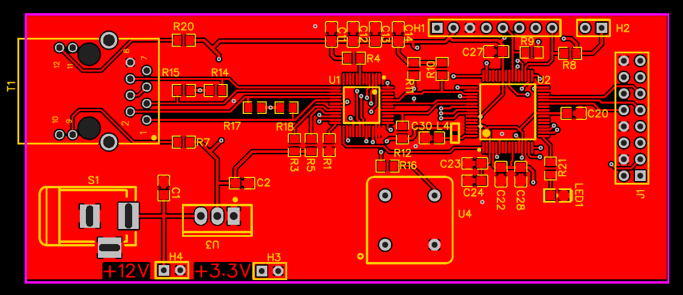
PCB Layout (Top Layer)
Jordan Johnson

Slide 28
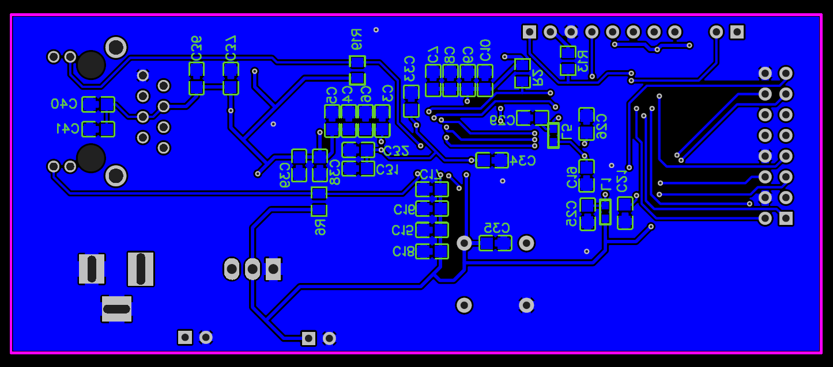
PCB Layout (Bottom Layer)
Jordan Johnson

Slide 29
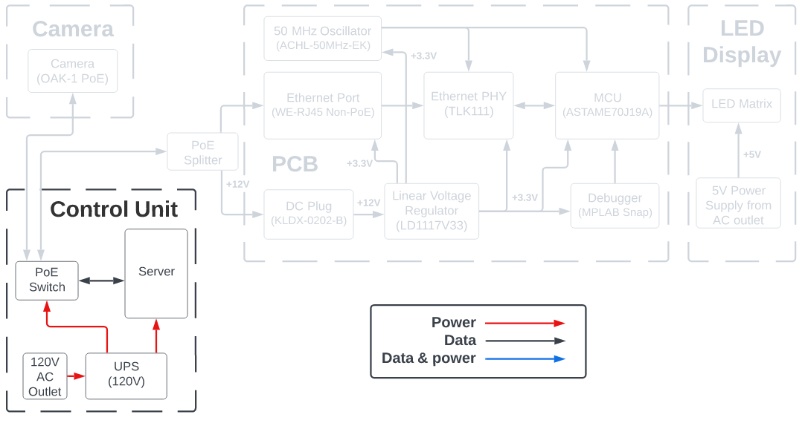
Control Unit - Hardware Block Diagram
Oscar Acuna
Notes:
Let’s talk about the control Unit:
The control unit is what seats between the camera and the Circuit Board that controls the LED displays.
It has a server, an ethernet Switch, and an a battery backup.
The cameras and the LED displays connect to the control unit via the Ethernet switch.
The idea is that when a camera detects cars are entering or leaving a section of the parking garage, it sends the change in available spaces to the server.
For example, let’s say the camera detects 2 cars entering a parking section; the camera will send a data package with a -2, which means there are two spaces less than before.
So, the server adds or subtracts that change from the total available spaces, it updates a local database, and it sends the new number of available spaces to the LED signs.

Slide 30
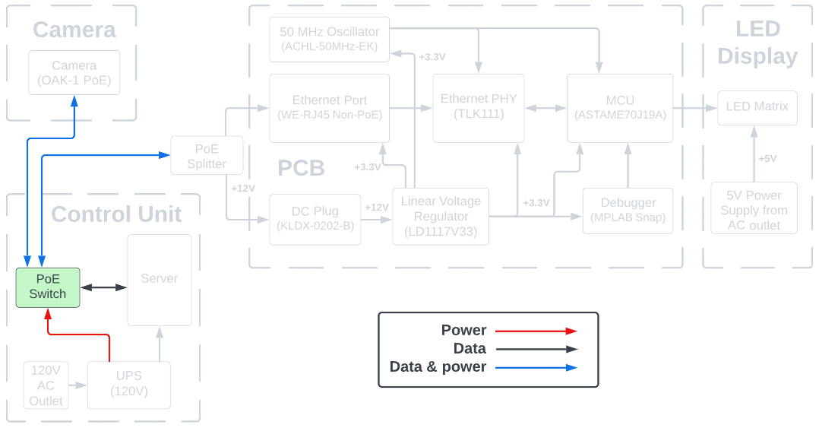
Control Unit - PoE Switch
Oscar Acuna
Notes:
Let’s talk about the Ethernet Switch first.
To power the Cameras and the PCB, we thought that using Power over Ethernet would be more cost effective than having traditional electric outlets throughout the garage.
Power over Ethernet (PoE) is a technology that allow us to inject or transmit electricity into the same cable that transmit the data.

Slide 31
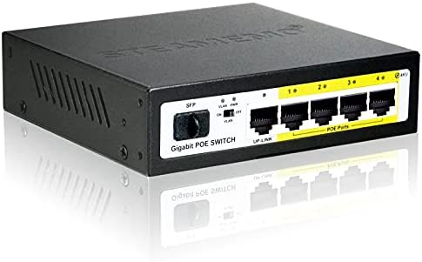
Control Unit - PoE Switch (Continued)
5-port PoE Ethernet Switch
Power over Ethernet (PoE)
PoE 802.3af
12.95 watts
Up to 350 mA
PoE switch comparison
Oscar Acuna
Brand | Model | No. of PoE ports | Price
Netgear | GS305P-100NAS | 4 PoE+ ports (Type 2) | $49.99
TP-Link | TL-SG1005P V2 | 4 PoE ports (Type 1) | $44.99
STEAMEMO | GPOE204 | 4 PoE+ ports (Type 2) | $33.99
Notes:
Deploying our parking system to an entire garage would require a switch with many more ports.
But, a small 5-port switch will be enough for our proof of concept.
There are different versions of PoE. There is PoE or Type 1, PoE+ or Type 2, all the way to type 4. Each provides even more power than the previous version
Now, the camera requires PoE Type 1 (802.3af), so we searched for PoE Type 1 ethernet switches.
And we found several options as shown in the table.
Type 2 PoE switches are backward compatible with Type 1.

Slide 32
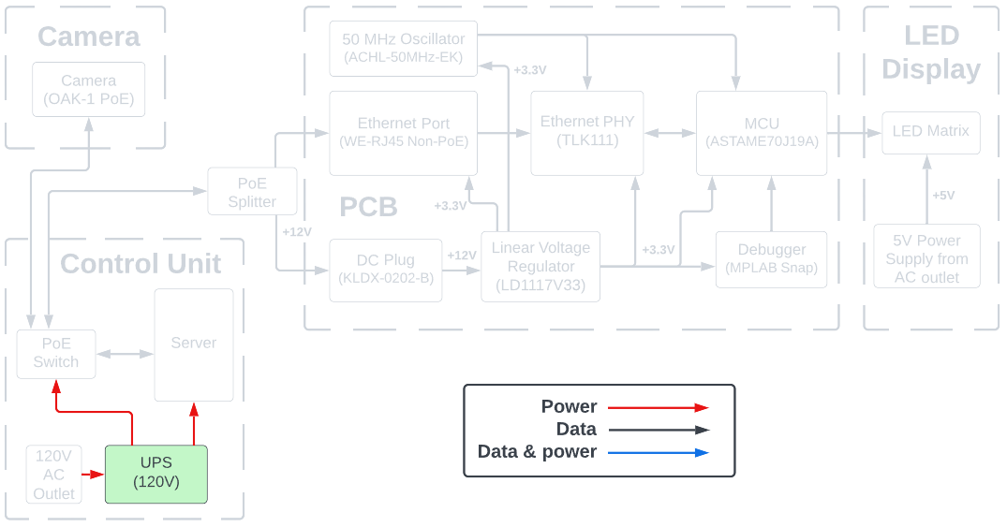
Control Unit - UPS (Battery Backup)
Oscar Acuna
Notes:
Let’s talk about the UPS or Battery Backup.

Slide 33
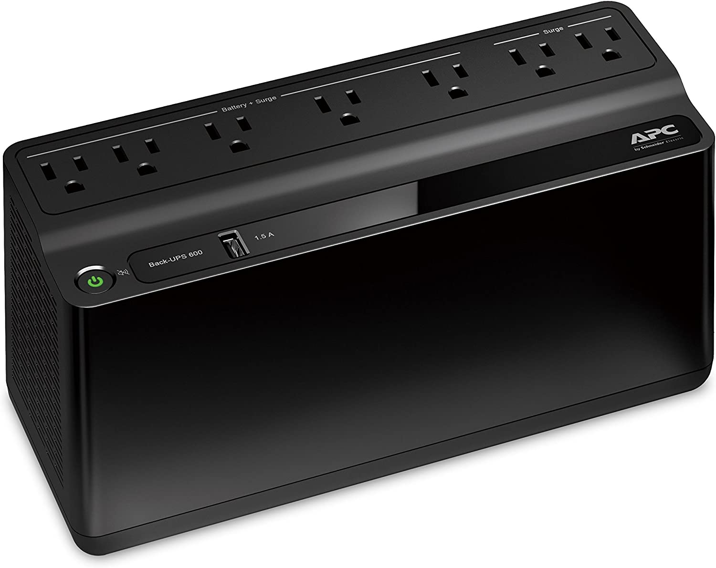
Control Unit - UPS (Battery Backup)
Uninterruptible Power Supply (UPS)
Battery Backup
~23 mins at 100 watts
Brand: APC
$75.99
Oscar Acuna
Notes:
For our project, we choose an UPS that could keep the system running for about 10 minutes.
It can keep cameras, the switch, and the server running in case of a power outage.
It can communicate with the server to turn if off gracefully in the event of a power outage.

Slide 34
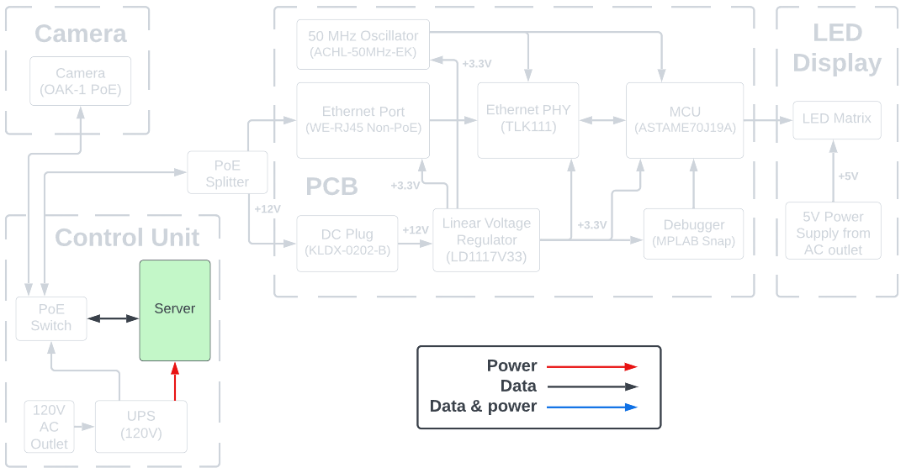
Control Unit - Server
Oscar Acuna
Notes:
Now let’s talk about the server:
We need three things for our parking system:
A place where to store the data captured by the camera.
A device to relay to the data from the cameras to the LED signs
A program to interact with the parking system, to configure it, display live data, keep track of available spaces, etc.
In other words, we needed a server that can support a database, that has an ethernet port, enough CPU and RAM capacity to run a custom program.

Slide 35
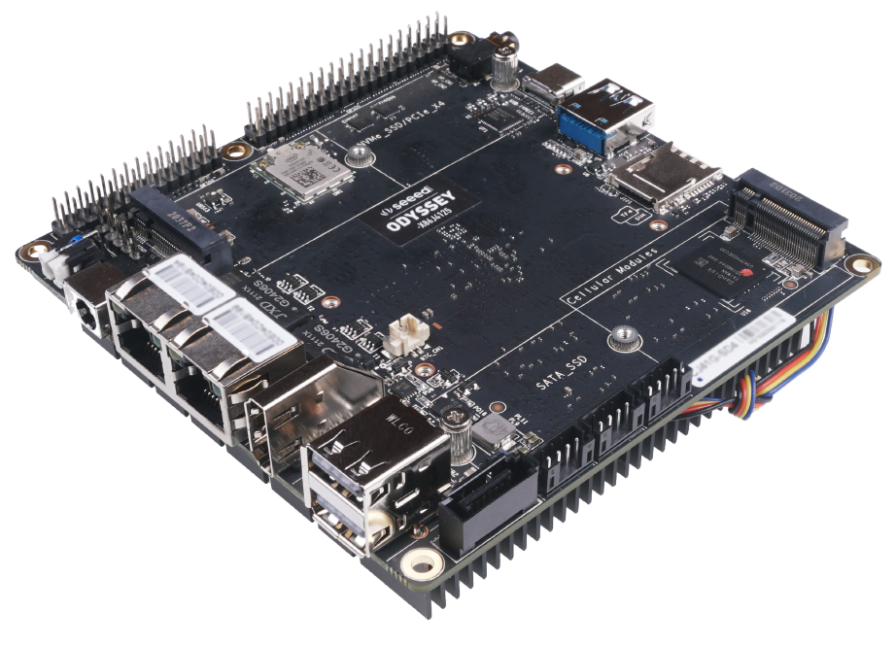
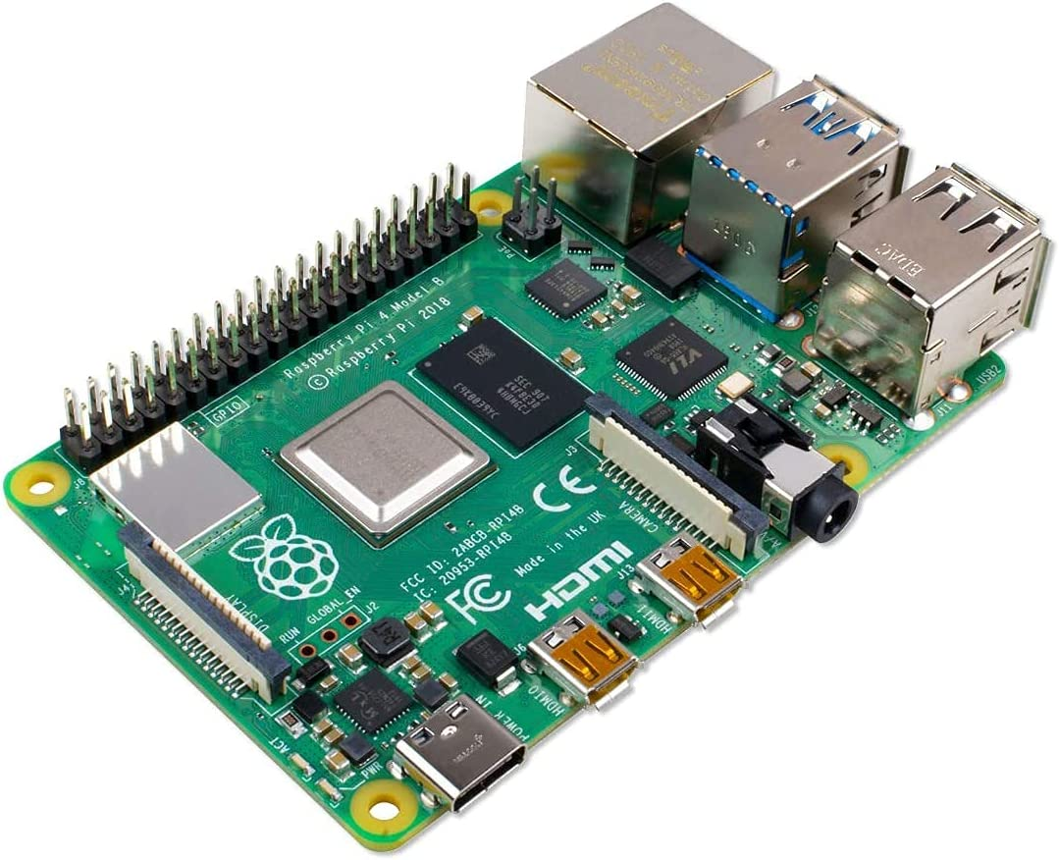
Control Unit - Server Hardware
Odyssey
Server Option Comparison
Raspberry Pi
Oscar Acuna
Brand | Model | CPU | RAM | Price
Seeed | Odyssey X86J4125864 | 2.0GHz 4C Intel Celeron J4125 | 8GB LPDDR4 | $238.00
Raspberry Pi | 4 Model B | 1.5GHz 4C Broadcom (ARM v8) | 8GB LPDDR4 | $184.95 (CanaKit)
UDOO | X86 II Advanced Plus | 1.6GHz 4C Intel Celeron N3160 | 4GB DDR3L | $214.00
Notes:
Now, the most cost effective computers are those that come with built-in CPU and Memory RAM, and usually have no expansion slot such as the Raspberry Pi, of those in the shown in the table. These boards are called Single-Board Computers and there are many options out there, although not all of them are available due to the chips availability.
Initially we had selected the Odyssey board because we can install Windows which is what we are using to develop the software.
However, this board is on backorder, and we may risk not getting on time. Therefore, we’ll most likely go with the Raspberry Pi.
Any of these board are capable of running Java and the database needed for our project.

Slide 36
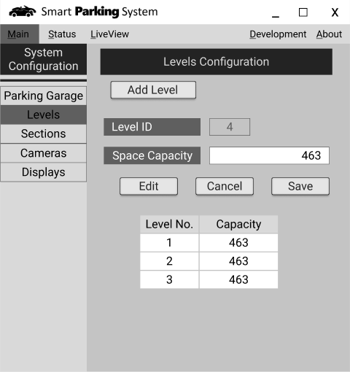
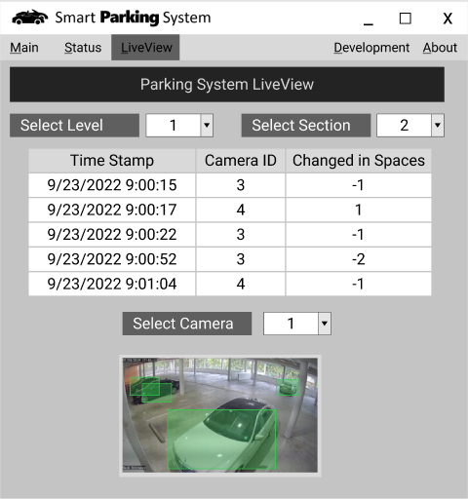
Control Unit - Server Software
Oscar Acuna
Notes:
Here is the Graphical User Interface of the parking system program we want to make.
Since I have some experience programming in JAVA, we decided to write the program using JAVA, and the Graphical Interface will be done using JavaFX.
In this program,
- There will be a section to configure the parking system, like adding cameras, displays, assigning IP addresses
- A section to display the status of the system
- A LiveView tab where we can see the video feed of a specific camera.

Slide 37
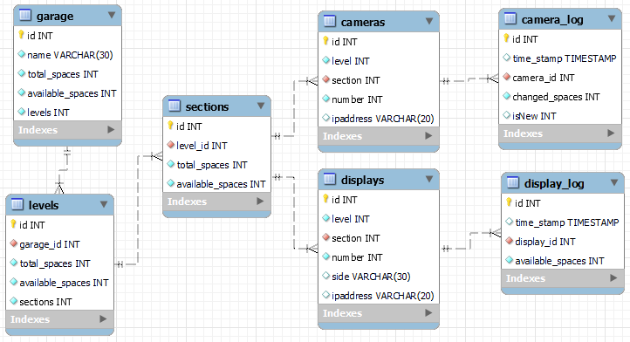
Control Unit - MySQL Database
Oscar Acuna
Notes:
All the parking system’s data will be stored in a database. Again, I have some experience with Java connecting to a MySQL Database, we decided to use MySQL as well.

Slide 38
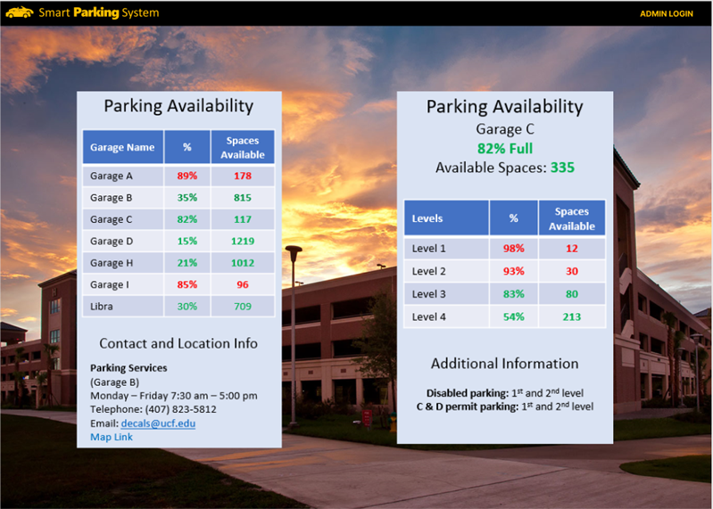
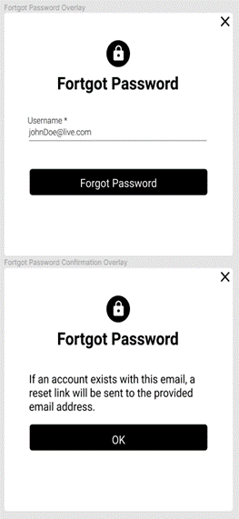

Stretch Goals (WebApp)
M Ridwan

Slide 39


Stretch Goals (WebApp)
M Ridwan

Slide 40


Stretch Goals (WebApp)
M Ridwan

Slide 41
Finance
M Ridwan
Item | Description | Qty | Availability | Unit Price | Price
Camera | Oak-1-PoE (with 10% discount) | 1 | Available | $224.10 | $224.10
LED Displays | RGB LED Matrix Panel - 32x64 | 2 | Available | $49.95 | $91.90
Custom PCB | PCB + Components estimate | 1 | TBD | $100 | $100
Power Supply (PCB & Displays) | Power Supply 12V/5V (2A) | 3 | Available | $10.95 | $32.85
Server Board | ODYSSEY - X86J4125864 | 1 | On backorder (6/3/2022) | $238.00 | $238.00
Wifi Router | GL.iNet GL-AR750S-Ext Gigabit | 1 | Available | $65.61 | $65.61
5-Port PoE Switch | STEAMEMO - GPOE204 | 1 | Available | $33.99 | $33.99
Heroku | Free Basic plan | 1 | Available | $0.00 | $0.00
MongoDB | Free Basic plan | 1 | Available | $0.00 | $0.00
Ethernet Cables | 25 feet Cat5e ethernet cable 3-foot patch ethernet cables cables | 2 3 | Already owned Already owned | $0.00 | $0.00
Miscellaneous | Parts | 1 |  | $100.00 | $100.00
 |  |  | Total |  | $886.45

Slide 42
Project Constraints
M Ridwan
Time
Economic
Testing
A semester of development time restrains many client facing UI/UX functionalities.
Implementation on a larger scale is not possible due to less development time.
High learning curve in limited time creates complexities in development.
The POE cameras are expensive which prevents the implementation of multiple cameras to improve the scope of the project.
With paid subscription to databases and deployment services; UX could be enhance.
Large LED devices could not be integrated.
Smart Parking is a system for UCF thus for testing, UCF authorities need to approve the processes.
It’s an outdoors project thus testing in different weather conditions and working around the UCF open hours can be challenging.

Slide 43
Project Constraints
M Ridwan
Health and Safety
Sustainability
Manufacturability
Dealing with high voltage for the power system must be done with caution.
Mounting the camera at higher positions(for better view of the parking space) need to done with supervision
The operating temperature of the components used in project must be monitored.
Smart parking system being an outdoors product, rough florida weather can affect the lifespan of the system.
Due to chip shortages a lot of electronic components are scarce. Working with the available inventory is a must.
With time and economic constraints; low stock of different IC may cause additional complexities in the development.

Slide 44

Project Completion (%)
Oscar Acuna
Notes:
Project Completion:
The Camera and Computer Vision software is 30%
The PCB LED displays is 35% completed
The Control Unit - Server Software: I am working on the GUI
For a Total Project Completion of about 34%

Slide 45
Related Standards
Oscar Acuna
Standard Type | Description
Power over Ethernet (PoE) | IEEE 802.3af-2003 Standard, to send data and electricity through a twisted-pair Ethernet cable.
Enclosure Ingress | International Protection Rating, IP65 Standard, offers protection from total dust ingress and low pressure water jets from any direction.
Ethernet | IEEE 802.3 standard, which supports the network technologies used in local area networks (LAN) and Wide Area Networks (WAN)
CAT6 Cables | ANSI/TIA-568 standard for commercial building cabling for telecommunication products and services.
PCB design | IPC-2221, a generic standard that covers aspects of PCB design.
Electronic Soldering | IPC J-STD-001, defines material and process requirements for soldered electrical and electronic assemblies.
Notes:
Here is a table of standard that impacted our project.

Slide 46
Plan for Completion
Oscar Acuna
Week of | Due Dates | Project Objectives
10/3/2022 | Project Summary 10/5, CDR 10/7
10/10/2022 |  | PCB Design
10/17/2022 |  | All additional parts ordered
10/24/2022 |  | Java GUI, PCB Print Ordered
10/31/2022 | Mid Term Video Demo due 10/31 | Vehicle Camera Recognition Programming
11/7/2022 | 8-Page Conference Paper 11/11 | Finish Control Unit, PCB Assembly & Test.
11/14/2022 |  | Java to LED Displays programming. Camera to Server Programming, and PCB MCU Programming
11/21/2022 | Showcase 8-min video due 11/26 Final Presentation 11/27 7-11 min Video due 11/28 | Work on Showcase video and Final Presentation.
11/28/2022 | Final Presentations 11/28 to 11/30 | Start Project Website.
12/5/2022 | Final Documentation due 12/6 | Finish Project Website
Notes:
This is our weekly plan to ensure project completion.

Slide 47
Thank You
www.SmartParkingSystem.xyz
Group B
Critical Design Review (CDR)

